Slide 1

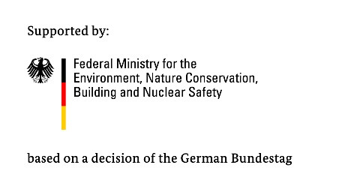
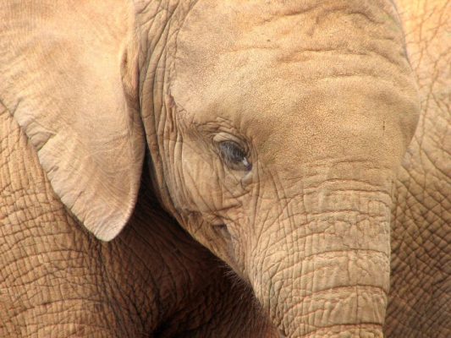
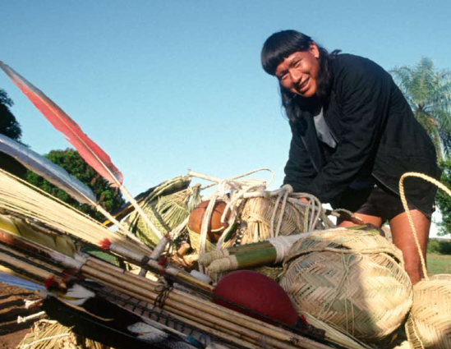
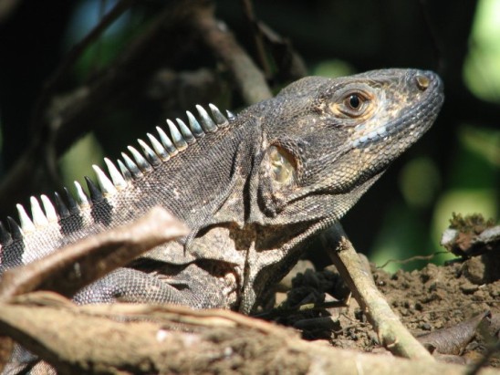
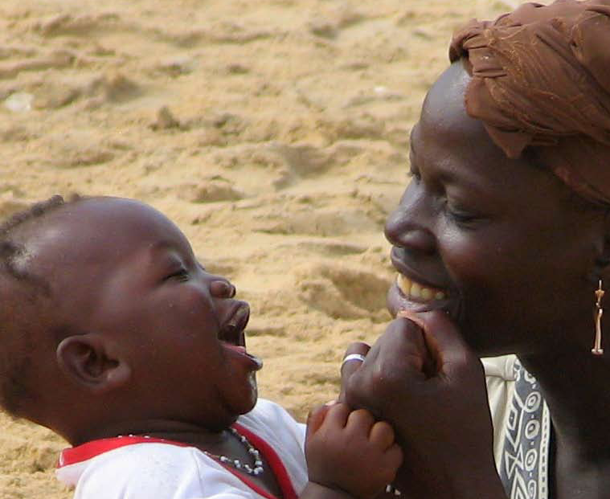
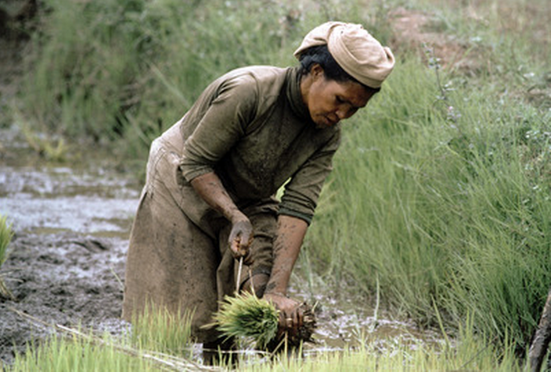
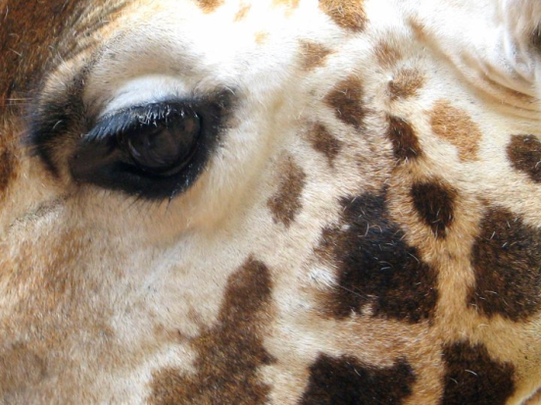
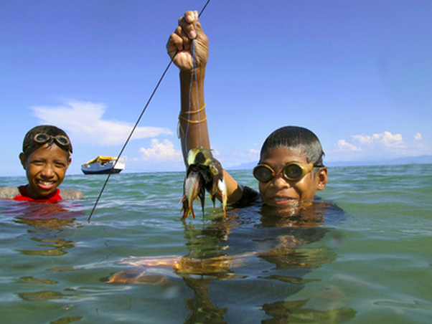
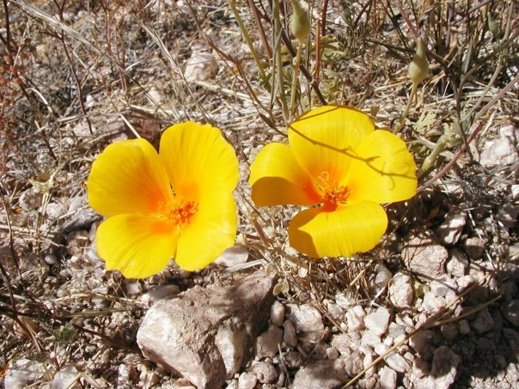
ICCAS AS NATURAL CLIMATE SOLUTIONS

Slide 2
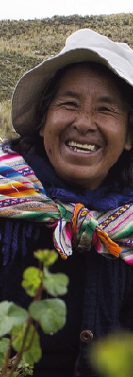



ICCAS AS NATURAL CLIMATE SOLUTIONS

Slide 3
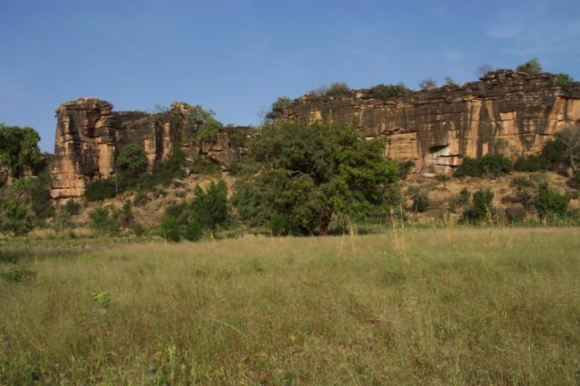
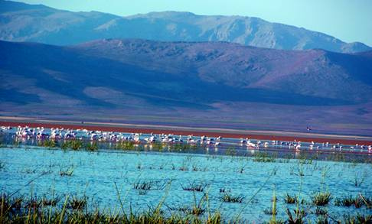

Protected Areas (PAs) and ICCAs
Relationship b/w ICCAs and protected areas is complex, and different cases are possible

Slide 4
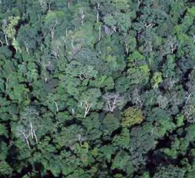
1. AVOID GHG/DEFORESTATION
ICCAs help to protect forests and other carbon-rich ecosystems, and therefore help to avoid the emissions of greenhouse gases.
Question: How has your community/ICCA helped to avoid greenhouse gas emissions?

Slide 5
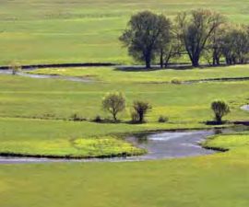
2. ENHANCE CARBON SEQUESTRATION
ICCAs help protect and manage ecosystems that can capture and store carbon, such as forests, mangroves and seagrass beds.
Question: How has your community/ICCA managed and protected ecosystems that capture carbon?

Slide 6
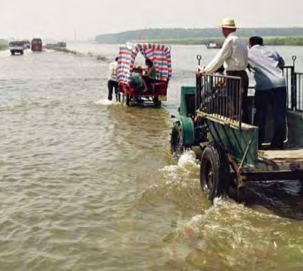
3. MITIGATE STORM IMPACTS
ICCAs protect ecosystems that can buffer the impacts of severe and more frequent catastrophic storms, such as hurricanes.
Question: How have ICCAs in your community helped to mitigate the impacts of natural disasters, such as hurricanes and floods?

Slide 7
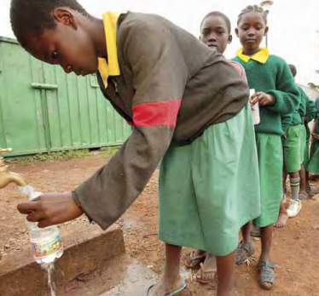
4. MAINTAIN WATER SECURITY
ICCAs protected ecosystems that maintain the quality and quantity of water necessary for sustainable development.
Question: How have ICCAs in your community helped to manage and protect ecosystems that maintain water security?

Slide 8
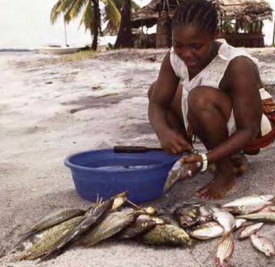
5. MAINTAIN FOOD SECURITY
ICCAs protected ecosystems that maintain the ecosystems necessary for food production.
Question: How have ICCAs in your community helped to manage and protect ecosystems that maintain food security?

Slide 9
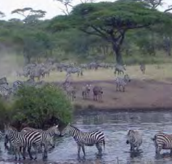
6. MAINTAIN HABITAT CONNECTIVITY
ICCAs protected ecosystems that connect to other protected areas, allowing species to shift their habitats.
Question: How have ICCAs in your community helped to promote connectivity between key habitats?

Slide 10
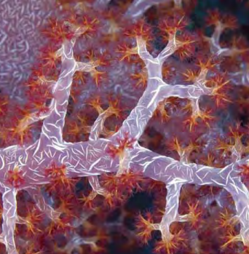
7. PROTECT VULNERABLE SPECIES
ICCAs protected ecosystems that protect species that are vulnerable to climate impacts.
Question: How have ICCAs in your community helped to protect habitats of species that are vulnerable to climate change impacts?

Slide 11
ICCAS AS NATURAL CLIMATE SOLUTIONS
PAPUA NEW GUINEA: Pagi Toko; Philiop Damen
BELIZE: Alfonso Esteban Caal; Cristina Coc; Pablo Miss
GUYANA: Tom Griffiths; Nicholas Fredericks
INDONESIA: Budi Setiawan

